Slide 1

SKIP LISTS
Prof. Zhenyu He
Harbin Institute of Technology, Shenzhen

Slide 2
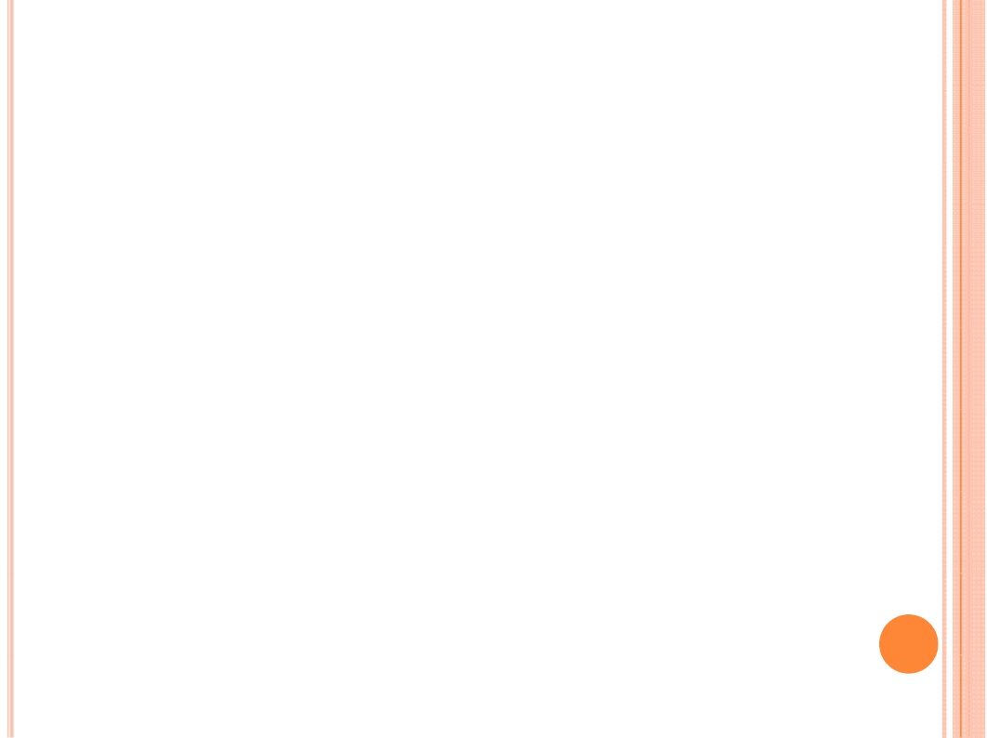
OUTLINE
Skip Lists
• Data structure
• Randomized insertion
• With-high-probability bound
• Analysis
• Coin flipping

Slide 3

Skip lists
• Simple randomized dynamic search structure
– Invented by William Pugh in 1989
– Easy to implement
• Maintains a dynamic set of n elements in
O(lg n) time per operation in expectation and
with high probability
– Strong guarantee on tail of distribution of T(n)
– O(lg n) “almost always”

Slide 4
One linked list
Start from simplest data structure:
(sorted) linked list
• Searches take Θ(n) time in worst case
• How can we speed up searches?
50
59
66
23
42
50
59
66
72
79
23
34
42
72
14
34

Slide 5
Two linked lists
Suppose we had two sorted linked lists
(on subsets of the elements)
• Each element can appear in one or both lists
• How can we speed up searches?
14
23
34
42
50
59
66
72
79

Slide 6
Two linked lists as a subway
IDEA: Express and local subway lines
(à la New York City 7th Avenue Line)
• Express line connects a few of the stations
• Local line connects all stations
• Links between lines at common stations
14
34
42
72
14
23
34
42
50
59
66
72
79

Slide 7
Searching in two linked lists
SEARCH(x):
• Walk right in top linked list (L )
1
until going right would go too far
• Walk down to bottom linked list (L₂)
• Walk right in L₂ until element found (or not)
14
34
42
72
14
23
34
42
50
59
66
72
79

Slide 8
Searching in two linked lists
EXAMPLE: SEARCH(59)
Too far:
59 < 72
14
34
42
72
14
23
34
42
50
59
66
72
79

Slide 9
Design of two linked lists
QUESTION: Which nodes should be in L₁?
• In a subway, the “popular stations”
• Here we care about worst-case performance
• Best approach: Evenly space the nodes in L₁
• But how many nodes should be in L₁?
14
34
42
72
14
23
34
42
50
59
66
72
79

Slide 10

Analysis of two linked lists
ANALYSIS:
$$\left|L_{1}\right|+ \frac{|L_{2}|}{|L_{1}|}$$
• Search cost is roughly
• Minimized (up to
constant factors) when terms are equal
•
$${|L_{1}^{ }|}^{2} = {|L}_{2}| =n ⇒\left|L_{1}\right|= \sqrt{n}$$
14
34
42
72
14
23
34
42
50
59
66
72
79

Slide 11




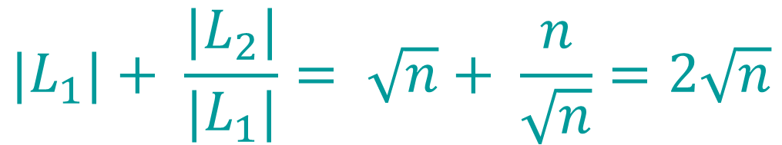

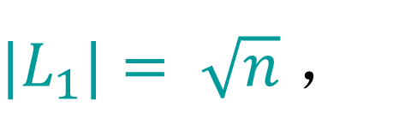
Analysis of two linked lists
ANALYSIS:
•
${|L}_{1}|= \sqrt{n}$ ，
$${|L}_{2}|=n$$
• Search cost is roughly
$${|L}_{1}|+ \frac{{|L}_{2}|}{{|L}_{1}|}= \sqrt{n}+ \frac{n}{\sqrt{n}}=2\sqrt{n}$$
}
14
42
66
$$\sqrt{n}$$
14
23
34
42
50
59
66
72
79
$$\sqrt{n}$$
$$\sqrt{n}$$
$$\sqrt{n}$$

Slide 12




More linked lists
What if we had more sorted linked lists?
$$2∙\sqrt{n}$$
• 2 sorted lists ⇒
• 3 sorted lists ⇒
$$3∙\sqrt[3]{n}$$
$$k∙\sqrt[k]{k}$$
• k sorted lists ⇒
• lg n sorted lists ⇒
$$\lg{n∙\sqrt[\lg{n}]{n}=2\lg{n}}$$
}
14
42
66
$$\sqrt{n}$$
14
23
34
42
50
59
66
72
79
$$\sqrt{n}$$
$$\sqrt{n}$$
$$\sqrt{n}$$

Slide 13

lg n linked lists
lg n sorted linked lists are like a binary tree
$$B^{+}$$
(in fact, level-linked -tree; see Problem Set 5)
14
79
14
50
14
79
14
14
34
50
66
79
14
50
59
66
14
23
34
42
72
79

Slide 14
Searching in lg n linked lists
EXAMPLE: SEARCH(72)
14
79
14
50
79
14
34
50
66
79
14
23
34
42
50
59
66
72
79

Slide 15
Skip lists
Ideal skip list is this lg n linked list structure
Skip list data structure maintains roughly this
structure subject to updates (insert/delete)
14
79
14
50
79
14
34
50
66
79
14
23
34
42
50
59
66
72
79

Slide 16
INSERT(x)
To insert an element x into a skip list:
• SEARCH(x) to see where x fits in bottom list
• Always insert into bottom list
INVARIANT: Bottom list contains all elements
• Insert into some of the lists above…
QUESTION: To which other lists should we add x?

Slide 17
INSERT(x)
QUESTION: To which other lists should we add x?
IDEA: Flip a (fair) coin; if HEADS,
promote x to next level up and flip again
• Probability of promotion to next level = 1/2
• On average:
– 1/2 of the elements promoted 0 levels
Approx.
balanced
?
– 1/4 of the elements promoted 1 level
– 1/8 of the elements promoted 2 levels
– etc.

Slide 18
Example of skip list
EXERCISE: Try building a skip list from scratch
by repeated insertion using a real coin
-∞
50
Small change:
• Add special −∞
-∞
34
50
value to every list
⇒ can search with
the same algorithm
-∞
23
34
42
50

Slide 19
Skip lists
A skip list is the result of insertions (and
deletions) from an initially empty structure
(containing just −∞)
• INSERT(x) uses random coin flips to decide
promotion level
• DELETE(x) removes x from all lists containing it

Slide 20
Skip lists
A skip list is the result of insertions (and
deletions) from an initially empty structure
(containing just −∞)
• INSERT(x) uses random coin flips to decide
promotion level
• DELETE(x) removes x from all lists containing it
How good are skip lists? (speed/balance)
• INTUITIVELY: Pretty good on average
• CLAIM: Really, really good, almost always

Slide 21
With-high-probability theorem
THEOREM: With high probability, every search
in an n-element skip list costs O(lg n)

Slide 22
With-high-probability theorem
THEOREM: With high probability, every search
in a skip list costs O(lg n)
• INFORMALLY: Event E occurs with high
probability (w.h.p.) if, for any α ≥ 1, there is an
appropriate choice of constants for which
E occurs with probability at least 1 − O(1/n^{α})
– In fact, constant in O(lg n) depends on α
• FORMALLY: Parameterized event E occurs
α
with high probability if, for any α ≥ 1, there is
an appropriate choice of constants for which
E occurs with probability at least 1 − c /n^{α}
α
α

Slide 23
With-high-probability theorem
THEOREM: With high probability, every search
in a skip list costs O(lg n)
• INFORMALLY: Event E occurs with high
probability (w.h.p.) if, for any α ≥ 1, there is an
appropriate choice of constants for which
E occurs with probability at least 1 − O(1/n^{α})
• IDEA: Can make error probability O(1/n^{α})
very small by setting α large, e.g., 100
• Almost certainly, bound remains true for entire
execution of polynomial-time algorithm

Slide 24
Boole’s inequality / union bound
Recall:
BOOLE’S INEQUALITY / UNION BOUND:
For any random events E , E , …, E ,
1 2
k
Pr{E ∪ E ∪ … ∪ E }
1
2
k
≤ Pr{E } + Pr{E } + … + Pr{E }
1
2
k
Application to with-high-probability events:
If k = n^{O(1)}, and each E occurs with high
i
probability, then so does E ∩ E ∩ … ∩ E
1
2
k

Slide 25
Analysis Warmup
LEMMA: With high probability,
n-element skip list has O(lg n) levels
PROOF:
• Error probability for having at most c lg n levels
= Pr{more than c lg n levels}
≤ n · Pr{element x promoted at least c lg n times}
(by Boole’s Inequality)
= n · (1/2^{c lg n})
= n · (1/n^{c})
= 1/n^{c − 1}

Slide 26
Analysis Warmup
LEMMA: With high probability,
n-element skip list has O(lg n) levels
PROOF:
• Error probability for having at most c lg n levels
≤ 1/n^{c − 1}
• This probability is polynomially small,
i.e., at most n^{α} for α = c − 1.
• We can make α arbitrarily large by choosing the
constant c in the O(lg n) bound accordingly.

Slide 27
Proof of theorem
THEOREM: With high probability, every search
in an n-element skip list costs O(lg n)
COOL IDEA: Analyze search backwards—leaf to root
• Search starts [ends] at leaf (node in bottom level)
• At each node visited:
– If node wasn’t promoted higher (got TAILS here),
then we go [came from] left
– If node was promoted higher (got HEADS here),
then we go [came from] up
• Search stops [starts] at the root (or −∞)

Slide 28
Proof of theorem
THEOREM: With high probability, every search
in an n-element skip list costs O(lg n)
COOL IDEA: Analyze search backwards—leaf to root
PROOF:
• Search makes “up” and “left” moves
until it reaches the root (or −∞)
• Number of “up” moves < number of levels
≤ c lg n w.h.p. (Lemma)
• ⇒ w.h.p., number of moves is at most the number
of times we need to flip a coin to get c lg n HEADs

Slide 29
Coin flipping analysis
CLAIM: Number of coin flips until c lg n HEADs
= Θ(lg n) with high probability
PROOF:
Obviously Ω(lg n): at least c lg n
Prove O(lg n) “by example”:
• Say we make 10 c lg n flips
• When are there at least c lg n HEADs?
(Later generalize to arbitrary values of 10)

Slide 30
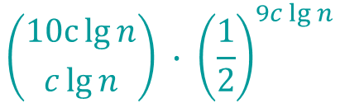
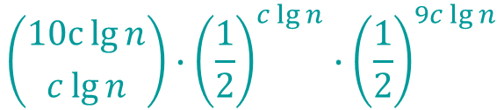
Coin flipping analysis
CLAIM: Number of coin flips until c lg n HEADs
= Θ(lg n) with high probability
PROOF:
$$\left({10c\lg{n} \atop c\lg{n}}\right)∙{\left(\frac{1}{2}\right)}^{c\lg{n}}∙{\left(\frac{1}{2}\right)}^{9c\lg{n}}$$
• Pr{exactly c lg n HEADs} =
orders HEADs TAILs
$$\left({10c\lg{n} \atop c\lg{n}}\right) ∙ {\left(\frac{1}{2}\right)}^{9c\lg{n}}$$
• Pr{at most c lg n HEADs} ≤
overestimate
on orders
TAILs

Slide 31




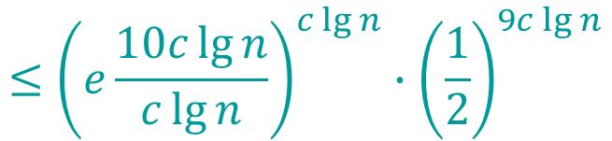
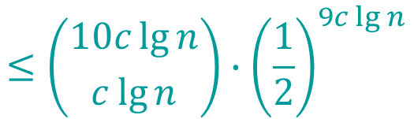
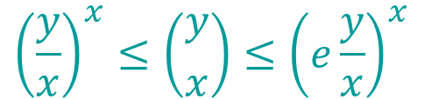


Coin flipping analysis (cont’d)
$$\left({y \atop x}\right)$$
$${\left(\frac{y}{x}\right)}^{x}≤\left({y \atop x}\right)≤{\left(e\frac{y}{x}\right)}^{x}$$
• Recall bounds on :
$$≤\left({10c\lg{n} \atop c\lg{n}}\right)∙{\left(\frac{1}{2}\right)}^{9c\lg{n}}$$
• Pr{at most c lg n HEADs}
$$≤{\left(e\frac{10c\lg{n}}{c\lg{n}}\right)}^{c\lg{n}}∙{\left(\frac{1}{2}\right)}^{9c\lg{n}}$$
$${=\left(10e\right)}^{c\lg{n}}2^{−9c\lg{n}}$$
$$=2^{\lg\left(10e\right)∙c\lg{n}}2^{−9c\lg{n}}$$
$$=2^{\left[\lg\left(10e\right)−9\right]∙c\lg{n}}$$
$$=1/{n^{α}}$$
for
$$α=\left[9−\lg\left(10e\right)\right]∙c$$

Slide 32
Coin flipping analysis (cont’d)
• Pr{at most c lg n HEADs} ≤ 1/n^{α} for α = [9−lg(10e)]c
• KEY PROPERTY: α → ∞ as 10 → ∞, for any c
• So set 10, i.e., constant in O(lg n) bound,
large enough to meet desired α
This completes the proof of the coin-flipping claim
and the proof of the theorem.

